Slide 1

Homomorphisms
Course Title: Advanced Cryptography
Course Code: ICT-6115
Presented By:
Md. Shamsuzzaman Miah
IT-23624
Department of ICT, MBSTU
Presented To:
Mr. Ziaur Rahman
Associate Professor
Dept. of ICT,MBSTU

Slide 2
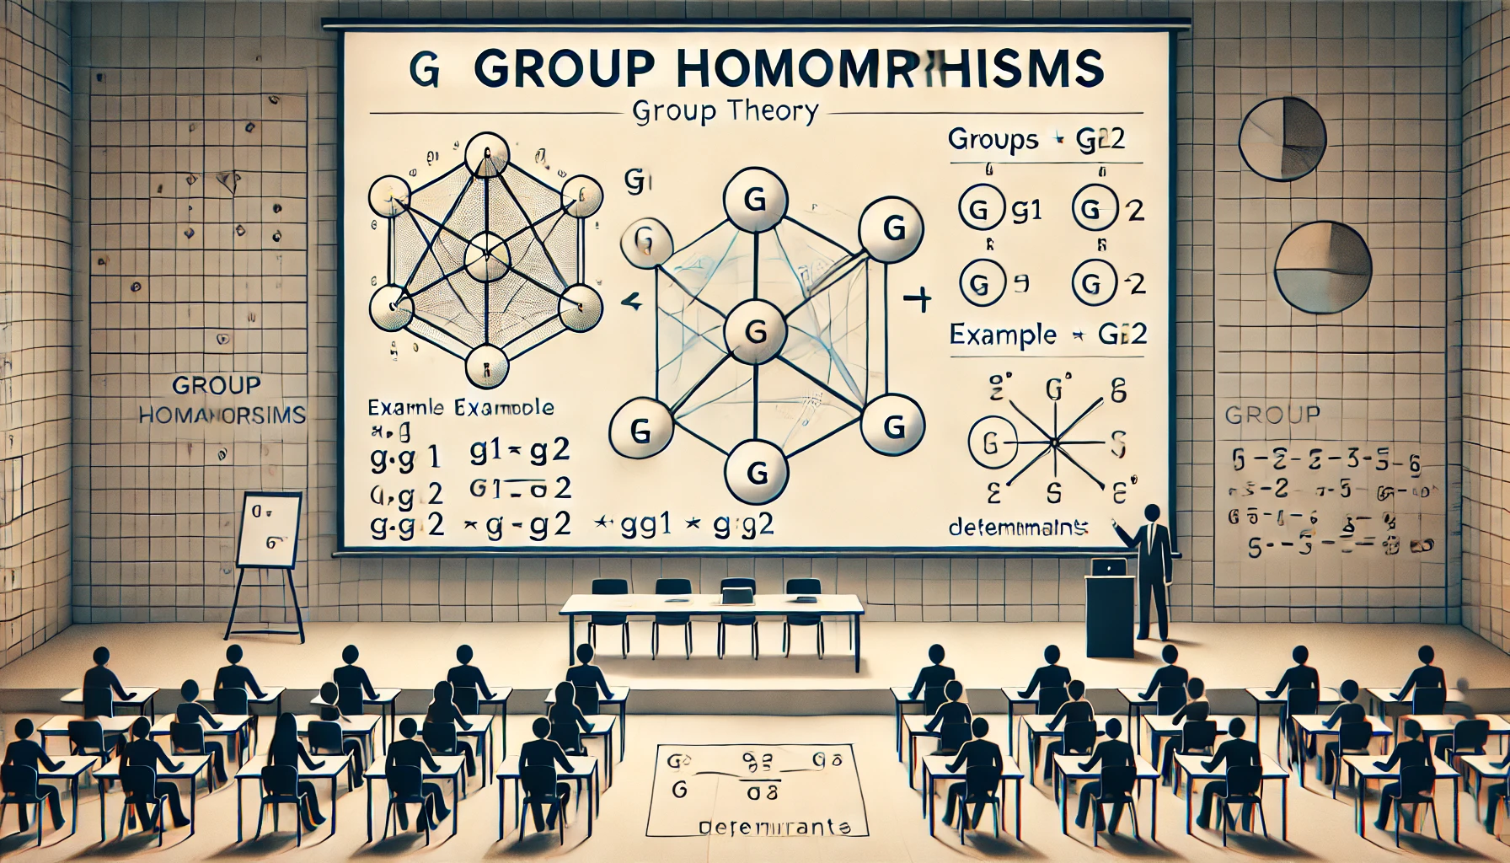
Group Homomorphisms
A homomorphism between groups (G, ·) and (H, ◦) is a map ϕ : G → H such that
ϕ(g1 · g2) = ϕ(g1) ◦ ϕ(g2)
for g1, g2 ∈ G. The range of ϕ in H is called the homomorphic image of ϕ

Slide 3
Homomorphisms
Throughout the course, we’ve said things like:
“This group has the same structure as that group.” “This group is isomorphic to that group.”
We will study a special type of function between groups, called a homomorphism.
An isomorphism is a homomorphism which is a bijection.
There are two situations where homomorphisms arise: when one group is a subgroup of another;
when one group is a quotient of another.
The corresponding homomorphisms are called embeddings and quotient maps.

Slide 4

Example
Consider the statement: Z3 < D3. Here is a visual:
0
e
0 '→ e
1 '→ r
2 '→ r ²
f
2
1
r ² f
rf
_{r} 2
r
The group D3 contains a size-3 cyclic subgroup ⟨r ⟩, which is identical to Z3 in structure only. None of the elements of Z3 (namely 0, 1, 2) are actually in D3.
When we say Z3 < D3, we really mean that the structure of Z3 shows up in D3.
In particular, there is a bijective correspondence between the elements in Z3 and those in the subgroup ⟨r ⟩ in D3. Furthermore, the relationship between the corresponding nodes is the same.
A homomorphism is the mathematical tool for succinctly expressing precise structural correspondences. It is a function between groups satisfying a few “natural” properties.

Slide 5
Homomorphisms
Using the previous example, we say that this function maps elements of Z3 to elements of D3. We may write this as
0
e
φ(n) = r^{n}
f
2
1
φ : Z3 −→ D3 .
r ² f
rf
_{r} 2
r
The group from which a function originates is the domain (Z3 in our example). The group into which the function maps is the codomain (D3 in our example).
The elements in the codomain that the function maps to are called the image of the function ({e, r , r ²} in our example), denoted Im(φ). That is,
Im(φ) = φ(G ) = {φ(g ) | g ∈ G } .
Definition
A homomorphism is a function φ : (G, ∗) → (H, ◦) between two groups satisfying
φ(a ∗ b) = φ(a) ◦ φ(b), for all a, b ∈ G .
Note that the operation a ∗ b is occurring in the domain G while φ(a) ◦ φ(b) occurs in the codomain H.

Slide 6




Homomorphisms
Remark
Not every function from one group to another is a homomorphism! The condition
φ(a ∗ b) = φ(a) ◦ φ(b) preserves the structure of G .
The φ(a ∗ b) = φ(a) ◦ φ(b) condition has visual interpretations on the level of Cayley diagrams and multiplication tables.
Domain Codomain
a
φ(a)
Cayley diagrams
b φ(b)
φ
ab = c
c
φ(a)φ(b) = φ(c)
φ(c)
b
φ(b)
 | c
 | φ(c)
Multiplication
tables
a
φ
φ(a)
Note that in the Cayley diagrams, b and φ(b) are paths; they need not just be edges.

Slide 7
The Fundamental Homomorphism Theorem
The following is one of the central results in group theory.
Fundamental homomorphism theorem (FHT)
If φ : G → H is a homomorphism, then Im(φ) ∼= G/ Ker(φ).
The FHT says that every homomorphism can be decomposed into two steps: (i) quotient out by the kernel, and then (ii) relabel the nodes via φ.
G
(Ker φ Œ G )
φ
Im φ
any homomorphism
q
i
quotient process
remaining isomorphism (“relabeling”)
,
G Ker φ
group of cosets

Slide 8
Proof of the FHT
Fundamental homomorphism theorem
If φ : G → H is a homomorphism, then Im(φ) ∼= G/ Ker(φ).
Proof
We will construct an explicit map i : G/ Ker(φ) −→ Im(φ) and prove that it is an
isomorphism.
Let K := Ker(φ), and recall that G/K := {aK : a ∈ G }. Define
i : G/K −→ Im(φ) , i : gK −→ φ(g ) .
Show i is well-defined : We must show that if aK = bK , then i (aK ) = i (bK ).
Suppose aK = bK . We have
aK = bK =⇒ b⁻¹aK = K =⇒ b⁻¹a ∈ K .
By definition of b⁻¹a ∈ Ker(φ),
1H = φ(b⁻¹a) = φ(b⁻¹) φ(a) = φ(b)⁻¹ φ(a) =⇒ φ(a) = φ(b) .
By definition of i : i (aK ) = φ(a) = φ(b) = i (bK ).
C

Slide 9
Proof of FHT (cont.) [Recall: i : G/K → Im(φ) , i : gK ›→ φ(g )]
Proof (cont.)
Show i is a homomorphism : We must show that i (aK · bK ) = i (aK ) i (bK ).
i (aK · bK ) = i (abK )
= φ(ab)
= φ(a) φ(b)
= i (aK ) i (bK )
(aK · bK := abK from Slides 3.5 “quotient groups”) (definition of i )
(φ is a homomorphism) (definition of i )
C
Thus, i is a homomorphism.
Show i is surjective (onto) :
This means showing that for any element in the codomain (here, Im(φ)), that some element in the domain (here, G/K ) gets mapped to it by i .
Pick any φ(a) ∈ Im(φ). By defintion, i (aK ) = φ(a), hence i is surjective. C

Slide 10
Consequences of the FHT
An alternative proof of Prop 1 part 3
If φ : G → H is a homomorphism, then Im φ < H.
A few special cases
If φ : G → H is an embedding, then Ker(φ) = {1G }. The FHT says that
Im(φ) ∼= G/{1G } ∼= G .
If φ : G → H is the map φ(g ) = 1H for all h ∈ G , then Ker(φ) = G , so the FHT says that
{1H } = Im(φ) ∼= G/G .
Let’s use the FHT to determine all homomorphisms φ : C4 → C3: By the FHT, G/ Ker φ ∼= Im φ < C3, and so | Im φ| = 1 or 3.
Since Ker φ < C4, Lagrange’s Theorem also tells us that | Ker φ| ∈ {1, 2, 4}, and hence | Im φ| = |G/ Ker φ| ∈ {1, 2, 4}.
Thus, | Im φ| = 1, and so the only homomorphism φ : C4 → C3 is the trivial one.

Slide 11
Types of homomorphisms
Example 3: Consider the following homomorphism θ : Z3 → C6, defined by
θ(n) = r ^{2n} :
0
1
0 '→ 1
1 '→ r ²
2 '→ r ⁴
_{r} 5
r
2
1
_{r} 4
_{r} 2
_{r} 3
It is easy to check that θ(a + b) = θ(a)θ(b): The red-arrow in Z3 (representing 1) gets mapped to the 2-step path representing r ² in C6.
A homomorphism φ : G → H that is one-to-one or “injective” is called an embedding: the group G “embeds” into H as a subgroup.
If φ(G ) = H, then φ is onto, or surjective.
Definition
A homomorphism that is both injective and surjective is an isomorphism.
An automorphism is an isomorphism from a group to itself.

Slide 12
Homomorphisms and generators
Remark 1
If we know where a homomorphism maps the generators of G , we can determine where it maps all elements of G .
For example, suppose φ : Z3 → Z6 was a homomorphism, with φ(1) = 4. Using this information, we can construct the rest of φ:
φ(2) = φ(1 + 1) = φ(1) + φ(1) = 4 + 4 = 2
φ(0) = φ(1 + 2) = φ(1) + φ(2) = 4 + 2 = 0.
Example
Suppose that G = ⟨a, b⟩, and φ : G → H, and we know φ(a) and φ(b). Using this information we can determine the image of any element in G . For example, for
g = a³b²ab, we have
φ(g ) = φ(aaabbab) = φ(a) φ(a) φ(a) φ(b) φ(b) φ(a) φ(b).
What do you think φ(a⁻¹) is ?

Slide 13
Basic properties of homomorphisms
Proposition 1
Let φ : G → H be a homomorphism. Denote the identity of G by 1G , and the identity of H by 1H .
φ(1G ) = 1H
φ(g ⁻¹) = φ(g )⁻¹
“φ sends the identity to the identity” “φ sends inverses to inverses”
Suppose J < G . Then φ(J) is a subgroup of H.
Suppose I < H. Then the preimage φ⁻¹(J) is a subgroup of G .
Proof
Observe that φ(1G ) φ(1G ) = φ(1G · 1G ) = φ(g ) = 1H · φ(1G ) . Therefore,
φ(1G ) = 1H . C
Take any g ∈ G . Observe that φ(g ) φ(g ⁻¹) = φ(gg ⁻¹) = φ(1G ) = 1H . Since
φ(g )φ(g ⁻¹) = 1H , it follows immediately that φ(g ⁻¹) = φ(g )⁻¹. C
Show that 1H ∈ φ(G ), that φ(J) is closed under the binary operation of H, and that the inverse of each element in φ(J) is also in φ(J).
See Prop 11.4 in Judson’s textbook:
abstract.ups.edu/aata/section-group-homomorphisms.html

Slide 14
A word of caution
A homomorphism φ : G → H is determined by the image of the generators of G , but
not all such image will work.
Example 4: suppose we try to define a homomorphism φ : Z3 → Z4 by φ(1) = 1.
Then we get
φ(2) = φ(1 + 1) = φ(1) + φ(1) = 2,
φ(0) = φ(1 + 1 + 1) = φ(1) + φ(1) + φ(1) = 3 .
This is impossible, because φ(0) = 0. (Identity is mapped to the identity.)
Example 5: That’s not to say that there isn’t a homomorphism φ : Z3 → Z4; note that there is always the trivial homomorphism between two groups:
φ : G −→ H , φ(g ) = 1H for all g ∈ G .
Example 6
Show that there is no embedding φ : Zn ‹→ Z, for n ≥ 2. That is, any such
homomorphism must satisfy φ(1) = 0.

Slide 15
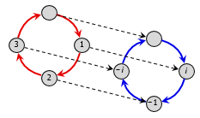
The Isomorphism Theorems
First Isomorphism Theorem: If ψ : G → H is a group homomorphism with K = ker ψ, then K is normal in G. Let ϕ : G → G/K be the canonical homomorphism. Then there exists a unique isomorphism η : G/K → ψ(G) such that ψ = ηϕ.
Second Isomorphism Theorem: Let H be a subgroup of a group G (not necessarily normal in G) and N a normal subgroup of G. Then HN is a subgroup of G, H ∩ N is a normal subgroup of H, and H/H ∩ N ∼= HN/N
Correspondence Theorem: Let N be a normal subgroup of a group G. Then H 7→ H/N is a one-to-one correspondence between the set of subgroups H of G containing N and the set of subgroups of G/N. Furthermore, the normal subgroups of G containing N correspond to normal subgroups of G/N.
Third Isomorphism Theorem: Let G be a group and N and H be normal subgroups of G with N ⊂ H. Then
G/H ∼= (G/N) / (H/N)

Slide 16


Isomorphisms
Sometimes, the isomorphism is less visually obvious because the Cayley graphs have different structure.
For example, the following is an isomorphism:
0
1
φ : Z6 −→ C6
φ(k) = r^{k}
5
1
_{r} 3
4
2
r
_{r} 5
_{r} 4
_{r} 2
3
Here is another non-obvious isomorphism between S3 = ⟨(12), (23)⟩ and D3 = ⟨r, f ⟩.
e
f
e
r ² f
φ : S3 −→ D3
φ : (12) −→ r ²f
φ : (23) −→ f
(23)
(12)
f
1
3 2
r
r ² f
rf
(132)
(132)
_{r} 2
r
(13)

Slide 17
How to show two groups are isomorphic
The standard way to show G =∼ H is to construct an isomorphism φ : G → H.
When the domain is a quotient, there is another method, due to the FHT.
Useful technique
Suppose we want to show that G/N ∼= H. There are two approaches:
Define a map φ : G/N → H and prove that it is well-defined, a homomorphism, and a bijection.
Define a map φ : G → H and prove that it is a homomorphism, a surjection (onto), and that Ker φ = N.
Usually, Method (ii) is easier. Showing well-definedness and injectivity can be tricky. For example, each of the following are results for which (ii) works quite well:
Z/⟨n⟩ ∼= Zn ;
Q∗/⟨−1⟩ ∼= Q⁺;
AB/B =∼ A/(A ∩ B) (assuming A, B Ð G );
G/(A ∩ B) =∼ (G/A) × (G/B) (assuming G = AB).

Slide 18
Cyclic groups as quotients
Consider the following (normal) subgroup of Z:
12Z = ⟨12⟩ = {. . . , −24, −12, 0, 12, 24, . . . } a Z .
The elements of the quotient group Z/⟨12⟩ are the cosets:
0 + ⟨12⟩ , 1 + ⟨12⟩ , 2 + ⟨12⟩ , . . . , 10 + ⟨12⟩ , 11 + ⟨12⟩ .
Number theorists call these sets congruence classes modulo 12. We say that two numbers are congruent mod 12 if they are in the same coset.
Recall how to add cosets in the quotient group:
(a + ⟨12⟩) + (b + ⟨12⟩) := (a + b) + ⟨12⟩ .
“(The coset containing a) + (the coset containing b) = the coset containing a + b.”
It should be clear that Z/⟨12⟩ is isomorphic to Z12. Formally, this is just the FHT applied to the following homomorphism:
φ : Z −→ Z12 , φ : k −→ k (mod 12) ,
Clearly, Ker(φ) = {. . . , −24, −12, 0, 12, 24, . . . } = ⟨12⟩. By the FHT:
Z/ Ker(φ) = Z/⟨12⟩ ∼= Im(φ) = Z12 .

Slide 19
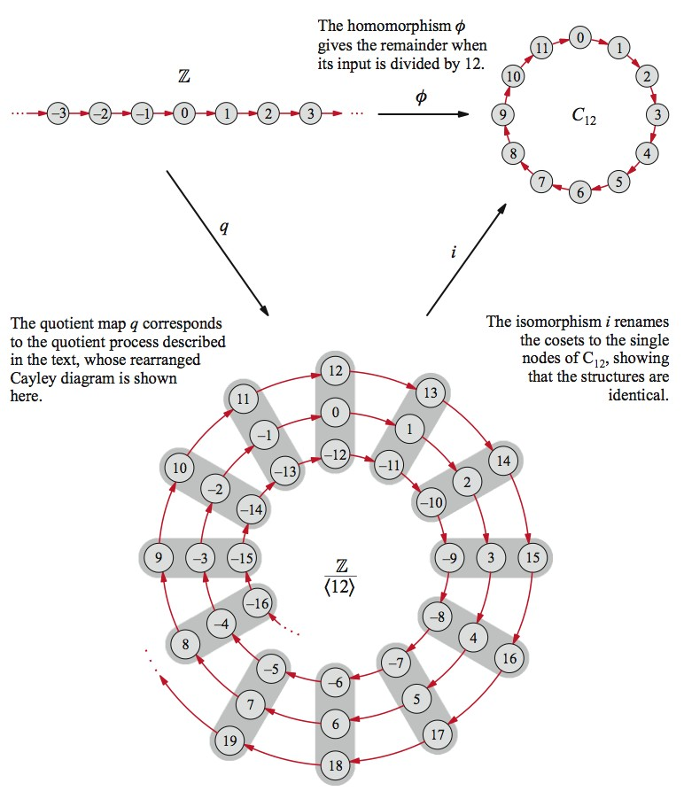
A picture of the isomorphism i : Z₁₂ −→ Z/⟨12⟩ (from the VGT website)

Slide 20
References
[1] Book: Abstract Algebra Theory and Applications by Thomas W. Judson, Stephen F. Austin State University
[2] Website: abstract.pugetsound.edu
[3] Website: https://www.math.clemson.edu/~macaule/classes/m20_math4120/slides/math4120_lecture-4-01_h.pdf
[4] Website: https://people.math.sc.edu/shaoyun/math5462slide9.pdf
[5] Website: https://egunawan.github.io/algebra/slides/sec4p3.pdf
[6] Website: https://tseppelt.github.io/assets/pdf/slides/20220707_slides_icalp.pdf
[7] Website: https://users.metu.edu.tr/matmah/2014-463/463.pdf

Slide 21



